Slide 1





MUSIC GENRE CLASSIFICATION USING
MACHINE LEARNING
BSC CS
2018-2021
PROJECT GUIDE : Dr. Mercy Paul Selvan
PROJECT MEMBERS : 1.Ms.V. Hemalatha
Register Number:38290024
2.Ms.S. Vinoba
Register Number:38290104
BATCH ID : CSE-8

Slide 2
CONTENT
Abstract
Aim of the project
Requirement Analysis
Existing system
Proposed System
Architecture diagram
Modules
Classification Algorithm
Results and performance analysis
conclusion
Reference

Slide 3
ABSTRACT
Music plays a very important role in people’s lives. Music brings like-minded people together and is the glue that holds communities together. Communities can be recognized by the type of songs that they compose, or even listen to. The purpose of our project and research is to find a better machine learning algorithm than the pre-existing models that predicts the genre of songs. Genres can be defined as categorical labels created by humans to identify or characterize the style of music. The concept of automatic music genre classification has become very popular in recent years as a result of the rapid growth of the digital entertainment industry. This work presents a comprehensive machine learning approach to the problem of automatic musical genre classification using the audio signal. The system is developed using a KNN and SVM to recognize the genre.

Slide 4
AIM OF THE PROJECT
Genre classification is an important task with many real world applications.to develop a deep learning project to automatically classify different musical genres from audio files. We will classify these audio files using their low-level features of frequency and time domain.
we need a dataset of audio tracks having similar size and similar frequency range. GTZAN genre classification dataset is the most recommended dataset for the music genre classification

Slide 5
REQUIREMENTS ANALYSIS
Hardware Requirements:
System : Pentium IV 2.4 GHz.
Hard Disk : 1TB
Floppy Drive : 1.44 Mb.
Monitor : 15 VGA Color.
Mouse : Logitech.
Ram : 8Gb.
Software Requirements:
Operating system : Windows 10
Coding Language : Python
IDE : Anaconda Navigator

Slide 6
EXISTING SYSTEM
In existing system, we used k-nearest neighbor (k-NN) to classify the genres. This doesn’t give an absolute reasonable correlation between learning strategies for classification of music genre. It uses filter modeling before Piecewise Gaussian Modeling. However, these improvements are not statistically significant. This procedure does not increase classification accuracy and it doesn’t achieve the efficiency prediction.

Slide 7
PROPOSED SYSTEM
Support Vector Machine (SVMs) have been actively used for various music classification tasks such as music tag- ging , genre classification and user-item latent feature prediction for recommendation. SVMs and KNNs assume features that are in different levels of hierarchy and can be extracted by convolutional kernels. The hierarchical features are learned to achieve a given task during supervised training.

Slide 8
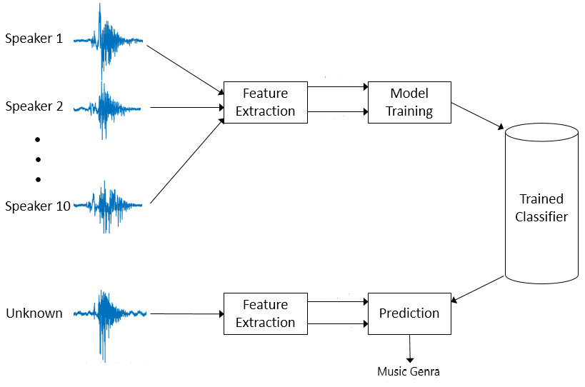
ARCHITECTURE DIAGRAM

Slide 9
ARCHITECTURE DIAGRAM
Feature Extraction: The process of feature extraction is useful when you need to reduce the number of resources needed for processing without losing important or relevant information. Feature extraction can also reduce the amount of redundant data for a given analysis. Also, the reduction of the data and the machine’s efforts in building variable combinations (features) facilitate the speed of learning and generalization steps in the machine learning process.
Model Training: A training model is a dataset that is used to train an ML algorithm. It consists of the sample output data and the corresponding sets of input data that have an influence on the output. The training model is used to run the input data through the algorithm to correlate the processed output against the sample output. The result from this correlation is used to modify the model. This iterative process is called “model fitting”. The accuracy of the training dataset or the validation dataset is critical for the precision of the model.

Slide 10
ARCHITECTURE DIAGRAM
Model training in machine language is the process of feeding an ML algorithm with data to help identify and learn good values for all attributes involved. There are several types of machine learning models, of which the most common ones are supervised and unsupervised learning. Supervised learning is possible when the training data contains both the input and output values. Each set of data that has the inputs and the expected output is called a supervisory signal. The training is done based on the deviation of the processed result from the documented result when the inputs are fed into the model.
Trained Classifier: Classification is the process of predicting the class of given data points. Classes are sometimes called as targets/ labels or categories. Classification predictive modeling is the task of approximating a mapping function (f) from input variables (X) to discrete output variables (y).
Prediction: The song genre is predicted from the input we provided

Slide 11
MODULES
Module 1: Data Preprocessing
Data Preprocessing is a process of transforming the raw, complex data into systematic understandable knowledge. It involves the process of finding out missing and redundant data in the dataset. Thus, this brings uniformity in the dataset. However, in our dataset, there was no missing values found meaning that every record was constituted its corresponding feature values.
Module 2: Feature Extraction
Feature extraction is a process of dimensionality reduction by which an initial set of raw data is reduced to more manageable groups for processing. A characteristic of these large data sets is a large number of variables that require a lot of computing resources to process. Feature extraction is the name for methods that select and /or combine variables into features, effectively reducing the amount of data that must be processed, while still accurately and completely describing the original data set.

Slide 12
MODULES
Module 3: Model Creation:
Algorithm’s Used:
• Support Vector Machine (SVM) algorithm
• K-nearest neighbours (KNN) algorithm

Slide 13
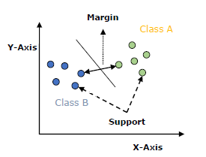
CLASSFICATION ALGORITHM
Working of SVM:
An SVM model is basically a representation of different classes in a hyperplane in multidimensional space. The hyperplane will be generated in an iterative manner by SVM so that the error can be minimized. The goal of SVM is to divide the datasets into classes to find a maximum marginal hyperplane (MMH).

Slide 14
CLASSFICATION ALGORITHM
The followings are important concepts in SVM :
Support Vectors: Datapoints that are closest to the hyperplane is called support vectors. Separating line will be defined with the help of these data points.
Hyperplane: As we can see in the above diagram, it is a decision plane or space which is divided between a set of objects having different classes.
Margin: It may be defined as the gap between two lines on the closet data points of different classes. It can be calculated as the perpendicular distance from the line to the support vectors. Large margin is considered as a good margin and small margin considered as a bad margin.
The main goal of SVM is to divide the datasets into classes to find a maximum marginal hyperplane (MMH) and it can be done in the following two steps: First, SVM will generate hyperplanes iteratively that segregates the classes in best way. Then, it will choose the hyperplane that separates the classes correctly.

Slide 15
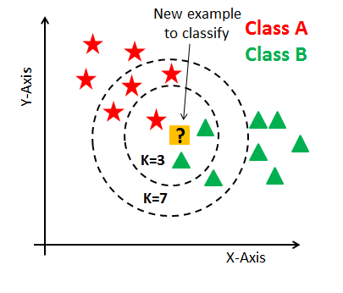
CLASSFICATION ALGORITHM
Working of KNN Algorithm:
K-nearest neighbors (KNN) algorithm uses ‘feature similarity’ to predict the values of new datapoints which further means that the new data point will be assigned a value based on how closely it matches the points in the training set. We can understand its working with the help of following steps:

Slide 16
CLASSFICATION ALGORITHM
Step 1: For implementing any algorithm, we need dataset. So, during the first step of KNN, we must load the training as well as test data.
Step 2: Next, we need to choose the value of K i.e., the nearest data points. K can be any integer.
Step 3: For each point in the test data do the following Calculate the distance between test data and each row of training data with the help of any of the method namely: Euclidean, Manhattan or Hamming distance. The most commonly used method to calculate distance is Euclidean. Now, based on the distance value, sort them in ascending order. Next, it will choose the top K rows from the sorted array. Now, it will assign a class to the test point based on most frequent class of these rows.
Step 4 – End

Slide 17

RESULTS AND PERFORMANCE ANALSIS
          Uploading the audio file:

Slide 18
RESULTS AND PERFORMANCE ANALSIS
This is the home page or the main page of our project. It is the web page created using html. Here it provides an option to upload a audio file. The audio file should be in wav format because of its accurate and lossless format. The user can choose a file and easily upload using the upload button.

Slide 19
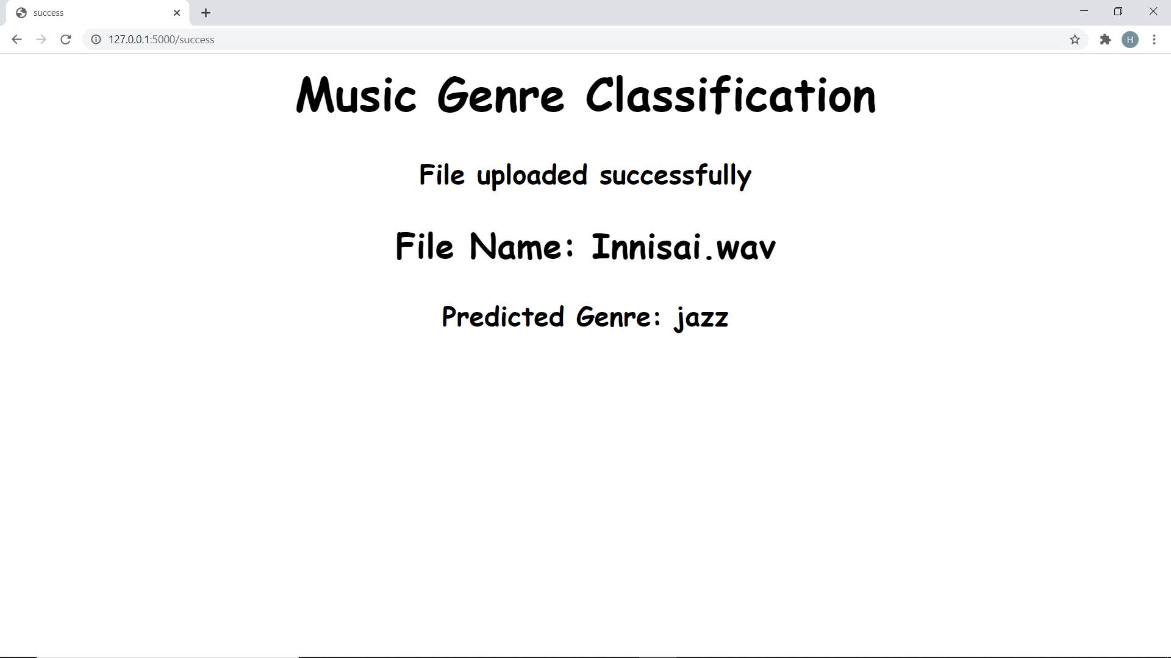
RESULTS AND PERFORMANCE ANALSIS

Slide 20
RESULTS AND PERFORMANCE ANALSIS
After the audio file is uploaded, within a few seconds it will display message that the file is uploaded successfully. It classifies the uploaded song file using machine learning techniques and predicts its genre with high accuracy. The Page provides the file name and its predicted genre.

Slide 21
CONCLUSION
We would like to address the multi-class problem with an ensemble of Machine Learning methods that could combine to create a confidence vector for each input, such as using our SVM and KNN models together. This would expand our findings to be used for a streaming service that can input several different genres and have some interesting results. In addition, we would like to experiment with different types like svm and knn this expose different implicit features in the dataset

Slide 22
REFERENCE
Music Genre Classification Using Independent Recurrent Neural Network, Wenli Wu ; Fang Han ; Guangxiao Song ; Zhijie Wang, 2018 Chinese Automation Congress (CAC)
Music Genre Classification and Recommendation by Using Machine Learning Techniques, Ahmet Elbir ; Hilmi Bilal Çam ; Mehmet Emre Iyican ; Berkay Öztürk ; Nizamettin Aydin, 2018 Innovations in Intelligent Systems and Applications Conference (ASYU)
Improve Music Genre Classification with Conv Nets, Rafael L. Aguiar ; Yandre M.G. Costa ; Carlos N. Silla, 2018 International Joint Conference on Neural Networks (IJCNN)
Genre Classification using Word Embeddings and Deep Learning, Akshi Kumar ; Arjun Rajpal ; Dushyant Rathore, 2018 International Conference on Advances in Computing, Communications and Informatics (ICACCI)
Music Genre Classification: A N-Gram Based Musicological Approach, Eve Zheng ; Melody Moh ; Teng-Sheng Moh, 2017 IEEE 7th International Advance Computing Conference (IACC)

Slide 23
REFERENCE
6. . .Long short-term memory recurrent neural network based segment features for music genre classification, Jia Dai ; Shan Liang ; Wei Xue ; Chongjia Ni ; Wenju Liu, 2016 10th International Symposium on Chinese Spoken Language Processing (ISCSLP)
7. TENCON 2019 - 2019 IEEE Region 10 Conference (TENCON)
8. Parallel Recurrent Convolutional Neural Networks Based Music Genre Classification Method for Mobile Devices, Rui Yang ; Lin Feng ; Huibing Wang ; Jianing Yao ; Sen Luo IEEE AccessYear: 2020
9. Music Genre Recognition Using Residual Neural Networks, Dipjyoti Bisharad ; Rabul Hussain Laskar
10. On Combining Diverse Models for Lyrics-Based Music Genre Classification ,Caio Luiggy Riyoichi Sawada Ueno ; Diego Furtado Silva, 2019 8th Brazilian Conference on Intelligent Systems (BRACIS)
11. Automatic Classification of Music Genre Using Masked Conditional Neural Networks, Fady Medhat ; David Chesmore ; John Robinson, 2017 IEEE International Conference on Data Mining (ICDM)

Slide 24
[29/02 4:02 pm] கா🌸😍: B.Sc
BSC CS
2018-2021
THANK YOU

